Slide 1
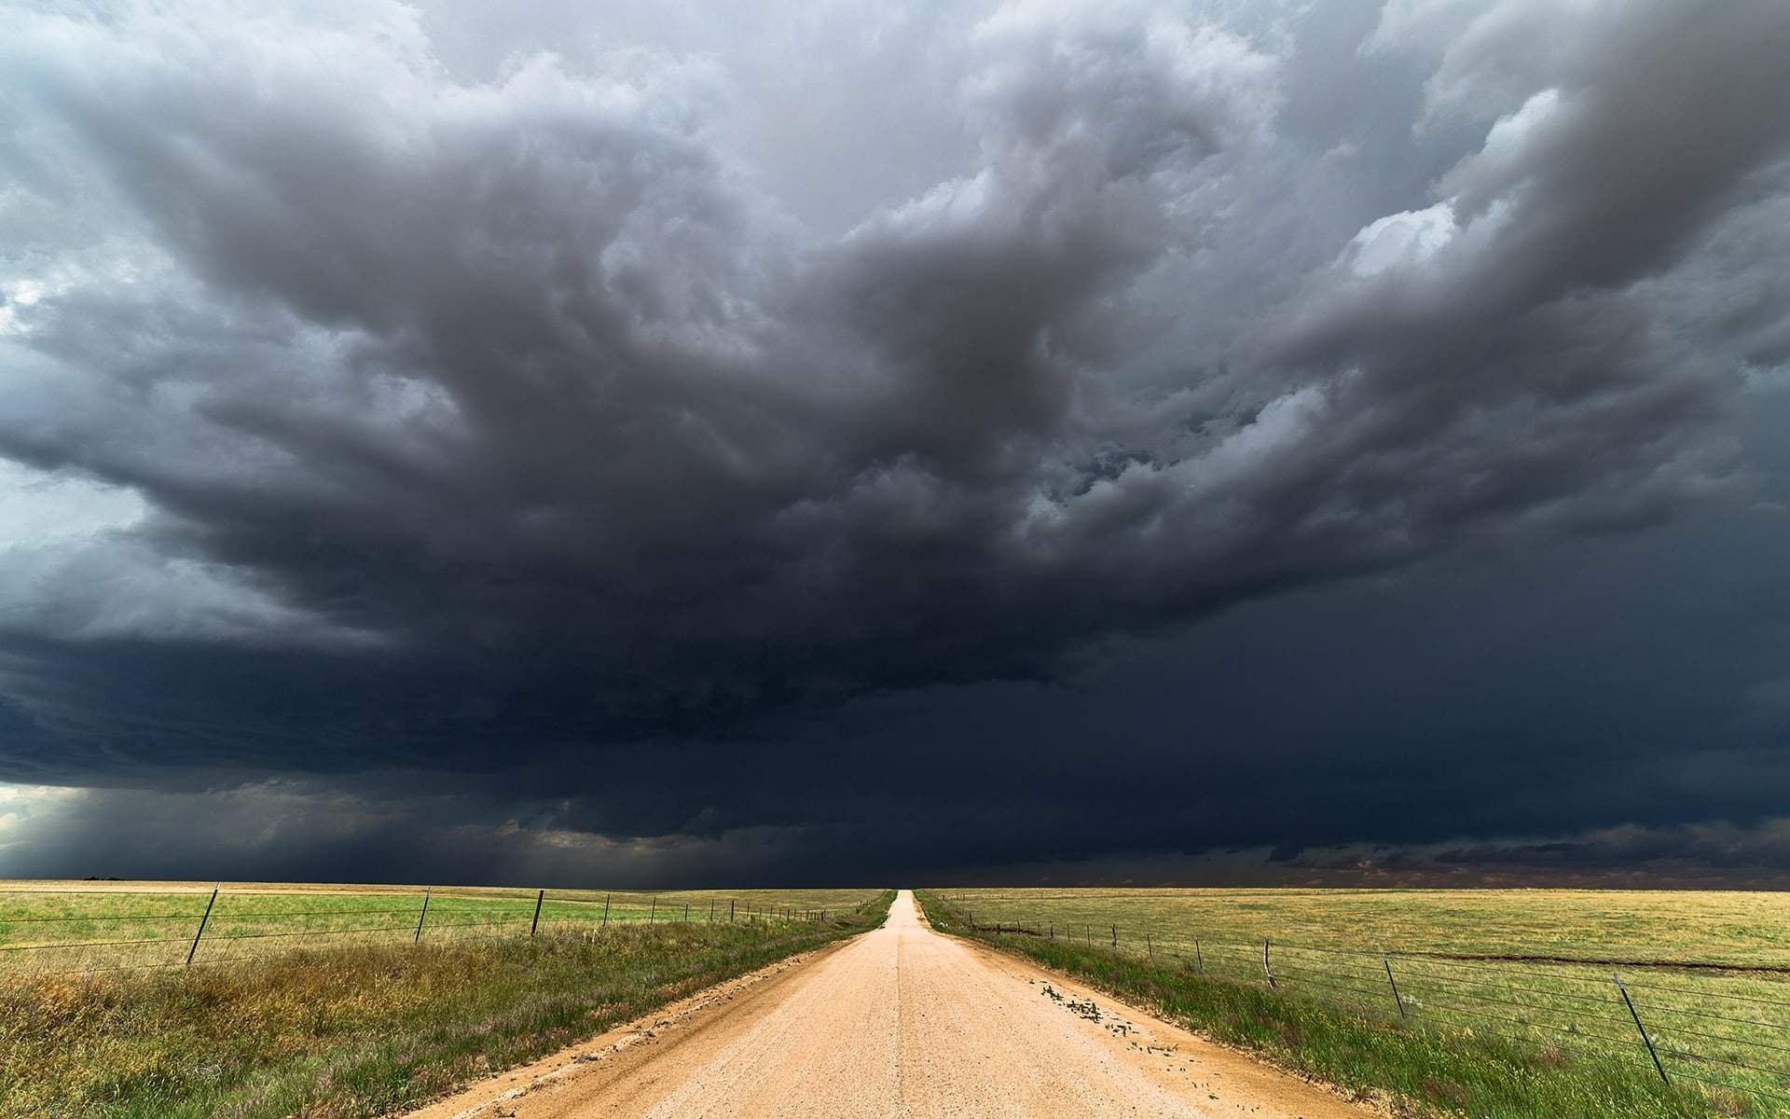
Tornado-n’t
A Caffeinated Clemson-ian Colloquium

Slide 2
Today’s Forecast
What is Wrong with This Dataset?
Establishing the Classical Frontier
Pushing the Quantum Envelope
Investor’s Note

Slide 3
What’s Wrong with This Dataset?

Slide 4

Missing Values
New feature maintains uncertainty
Fill values with unassuming value
**Fit to training set to avoid leakage

Slide 5
Dataset Imbalance
Attempted:
SMOTE
BorderlineSMOTE
SMOTENC
SMOTEN
SVMSMOTE
ADASYN
KMeansSMOTE
Best Performance:
SMOTE
Not enough data to be picky
Adapts easily to multivariate

Slide 6
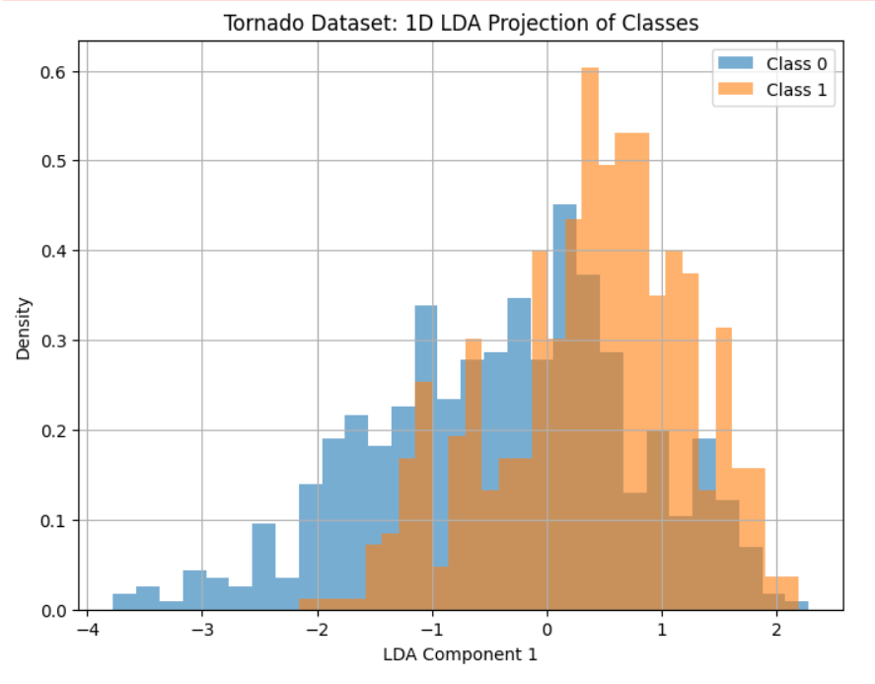
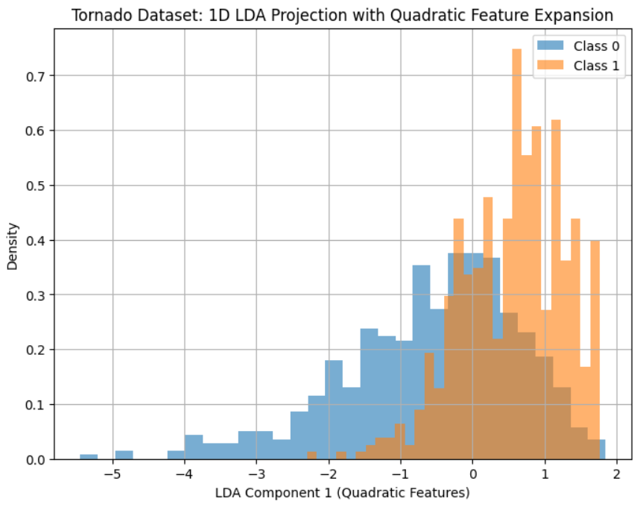
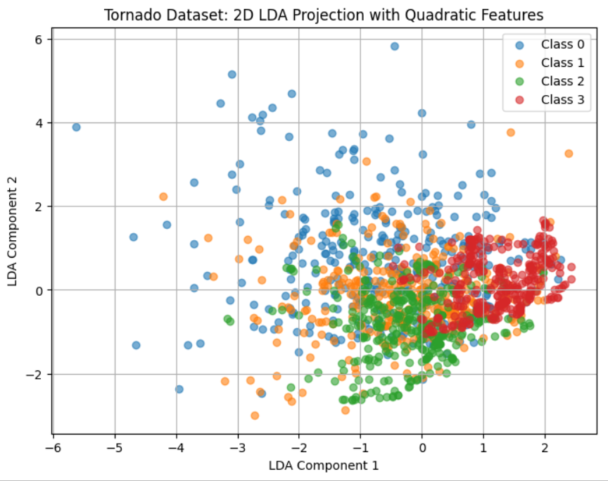
Separability
LCA Analysis: Data not even quadratically separable!

Slide 7
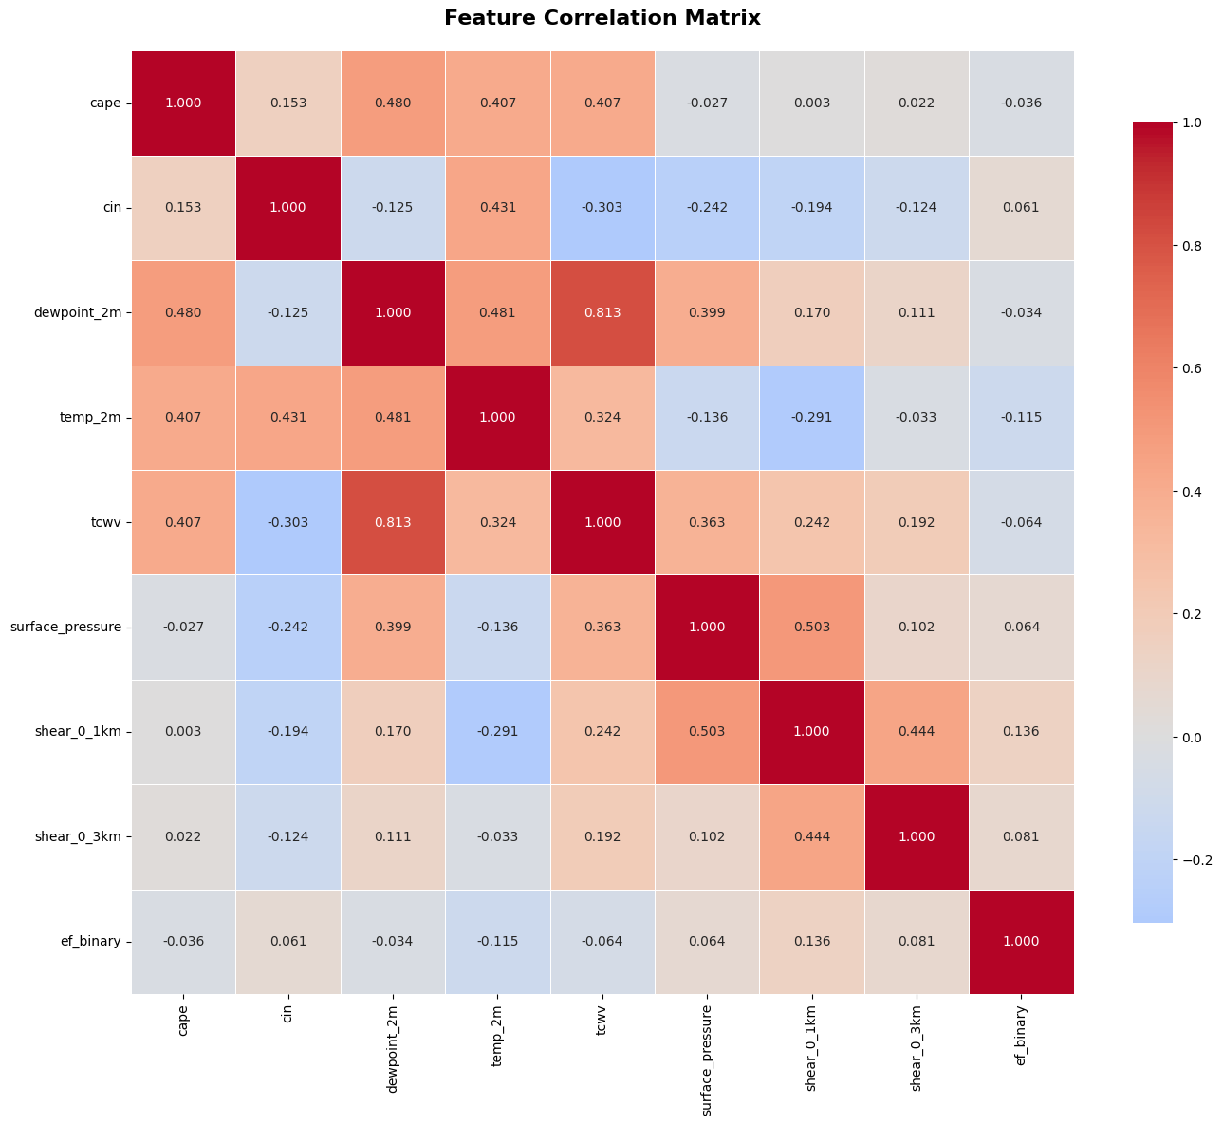
Correlation
No features correlate strongly with ef_binary!
Two closest features are closely related!
Spoiler: We need more features!

Slide 8

Establishing the Classical Frontier

Slide 9
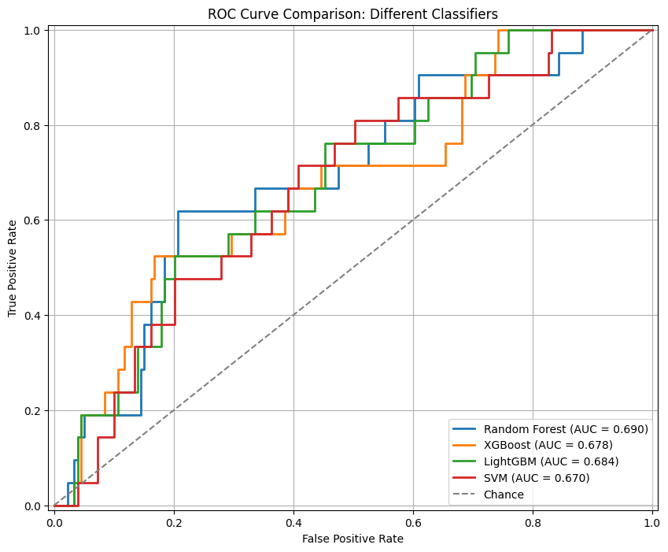
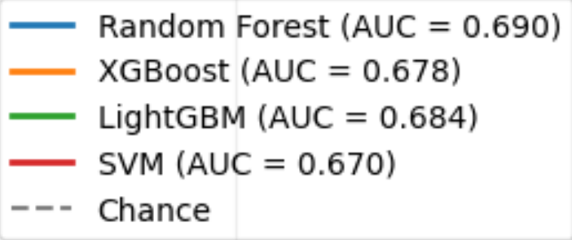
Classical Overview
Positive Results For:
Random Forest
XGBoost
LightGBM
SVM
Best (Barely):
Random Forest: AUC=0.690
Higher precision, lower recall than others
Data too poor for models to succeed

Slide 10
Room for Improvement: What are the Limitations?
Problem
Potential Mitigation
Linearly inseparable data
strong nonlinearity
Weak feature correlation
larger/stronger feature set

Slide 11
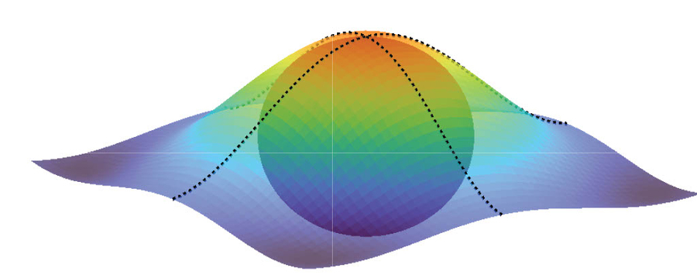
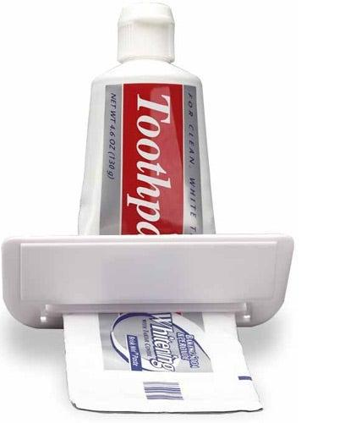
Pushing the Quantum Envelope
Classical Solution
Where can quantum eek out a bit extra?
Quantum Additions

Slide 12
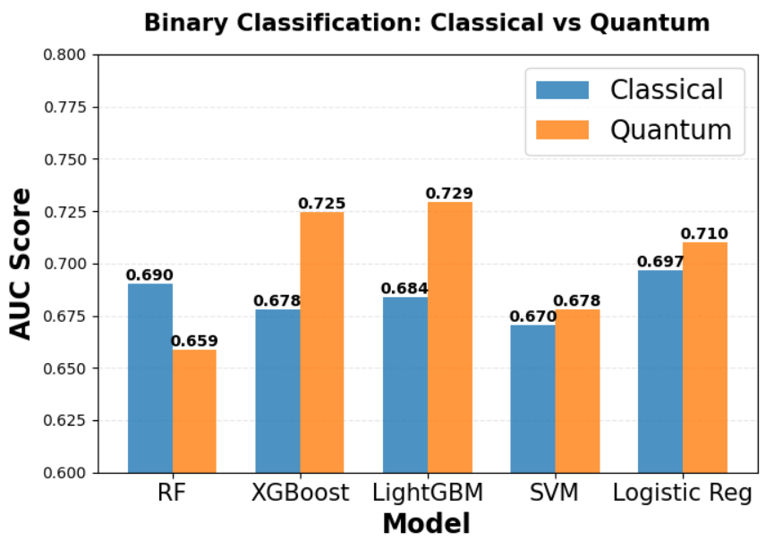
Model Attempts
Attempts:
QNN
QSVM
Solid Binary and Multi-class performance
Q Feature Selection - BEST
Capitalizes on classical progress
Offers nonlinearity and robust features
Q Feature Embedding
Trained Q Autoencoder

Slide 13
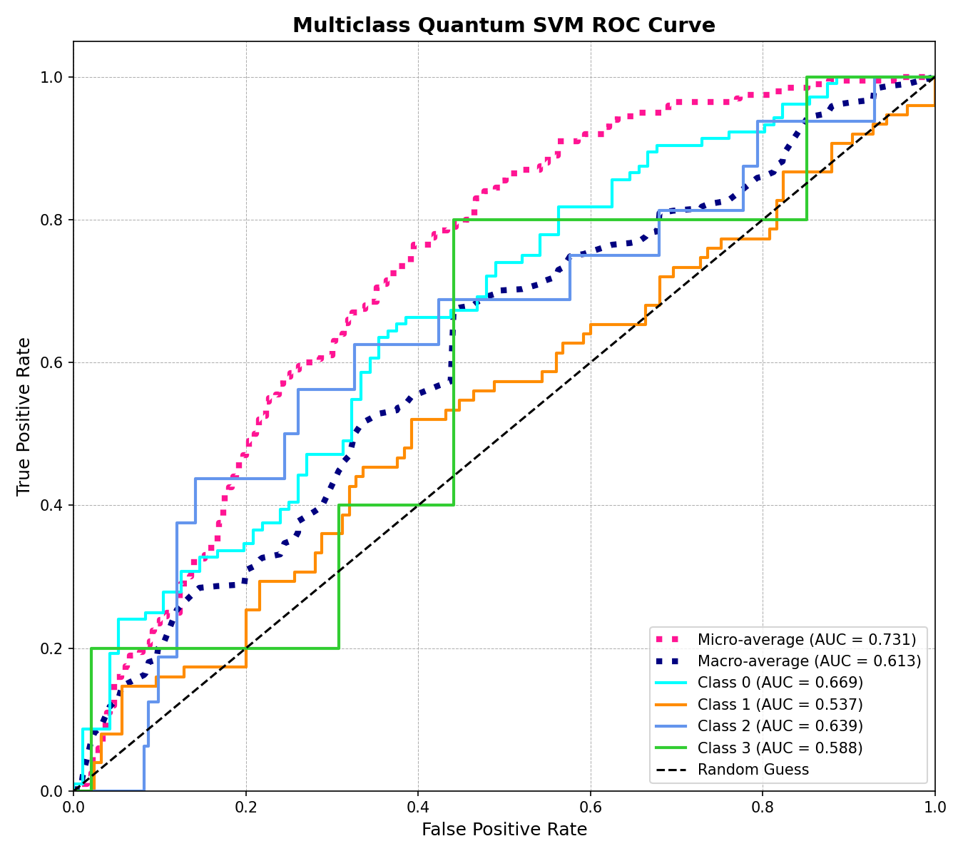
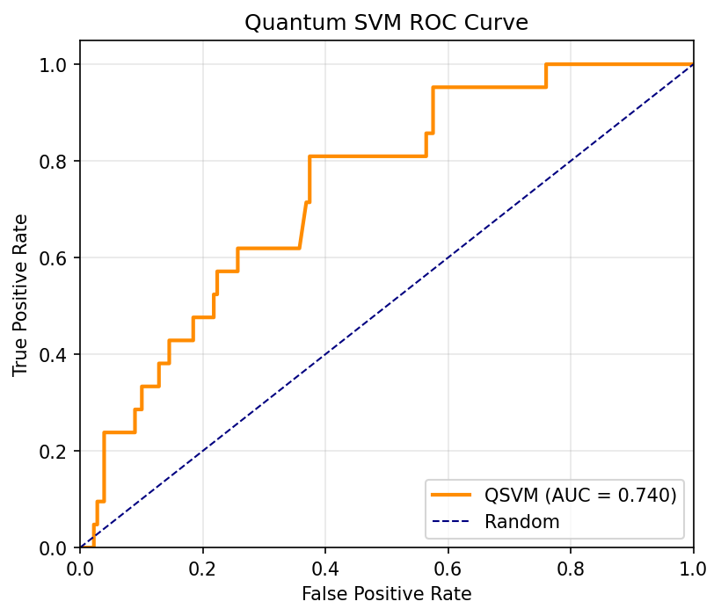
QSVM and QNN for binary vs. multi-class
Principal Component Analysis (PCA)
extract the most important features
Hyperparameter tuning
QSVM: maximize AUC
QNN: adam optimizer for learning rate and early stopping for overfitting
Frameworks
Cirq
Pennylane
Qiskit

Slide 14
Quantum Technique Analysis
Angle encoding:
amplitude encoding limits circuits to quadratic nonlinearity (Shaozhi Li et. al, 2024)
provides potentially limitless nonlinearity
Reuploading:
circumvents no-cloning theorem to increase expressivity
2^{N}-dimensional Hilbert Space:
Potentially problematic for optimization, but beneficial for difficult classification boundaries

Slide 15
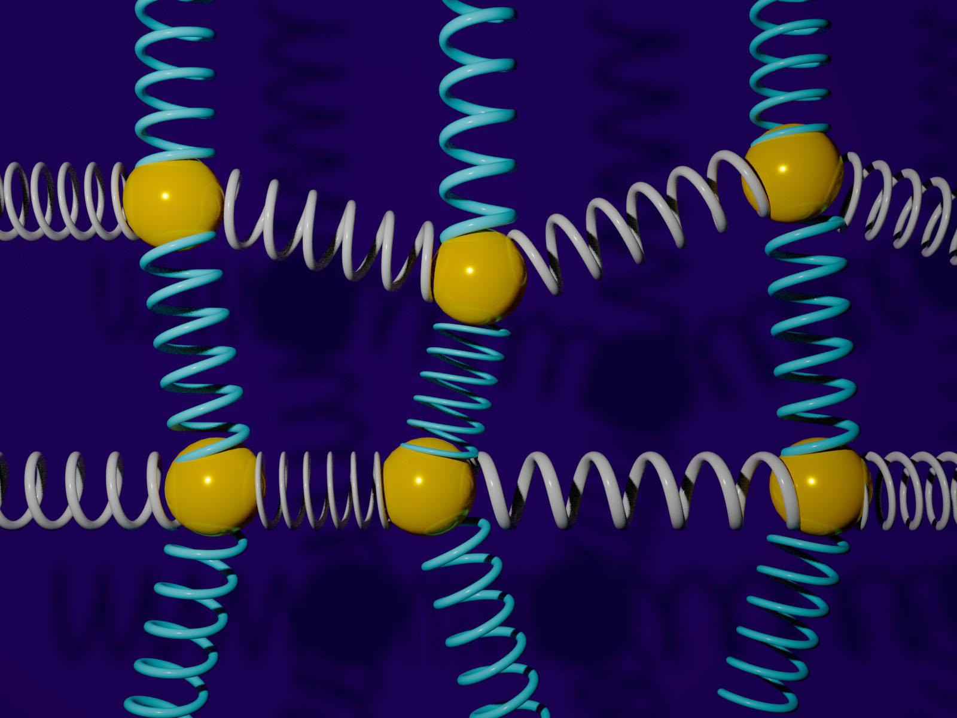
Extensions

Slide 16
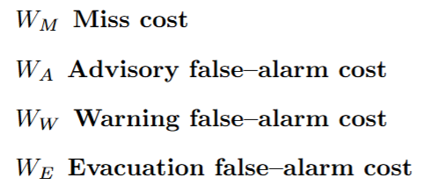
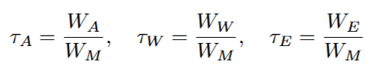
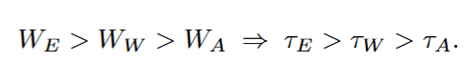
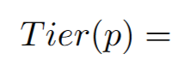

Weights and Cutoffs: How We Trigger Alerts
Define Weight
Threshold from weights

Slide 17
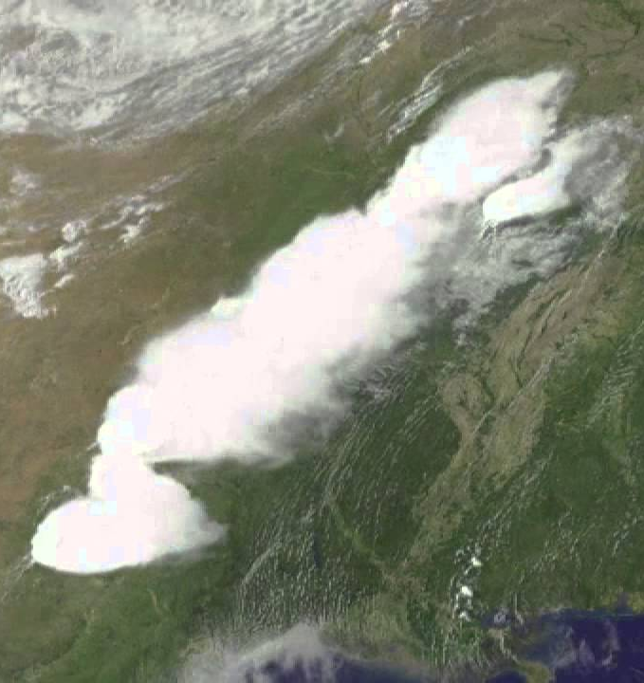
Requesting More Data
Timeseries/Radar Data
QRNNs → higher accuracy for timeseries data
Timeseries → LOTS of data
Location/Geographic Data
i.e. U.S. has more tornadoes than any other country
Satellite Images
Tornado-bearing storm as seen from space

Slide 18
Requesting More Time
Thorough feature selection
PCA/LCA analysis
Correlation
Add QNN for multi-class and use Cirq and Qiskit frameworks

